Slide 1

def get_pdf_probability(dataset,startrange,endrange):
from matplotlib import pyplot
from scipy.stats import norm
import seaborn as sns
ax = sns.distplot(dataset,kde=True,kde_kws={'color':'blue'},color='Green')
pyplot.axvline(startrange,color='Red')
pyplot.axvline(endrange,color='Red')
# generate a sample
sample = dataset
# calculate parameters
sample_mean =sample.mean()
sample_std = sample.std()
print('Mean=%.3f, Standard Deviation=%.3f' % (sample_mean, sample_std))
# define the distribution
dist = norm(sample_mean, sample_std)
values = [value for value in range(startrange, endrange)]
#probabilities = [dist.pdf(value) for value in values]
probabilities = []
for value in values:
probabilities.append(dist.pdf(value))
prob=sum(probabilities)
print("The area between range({},{}):{}".format(startrange,endrange,sum(probabilities)))
return prob

Slide 2
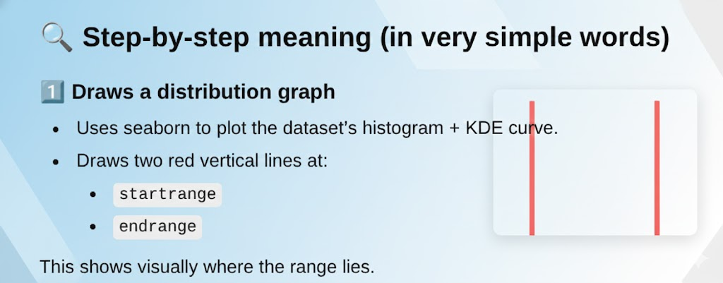

Slide 3
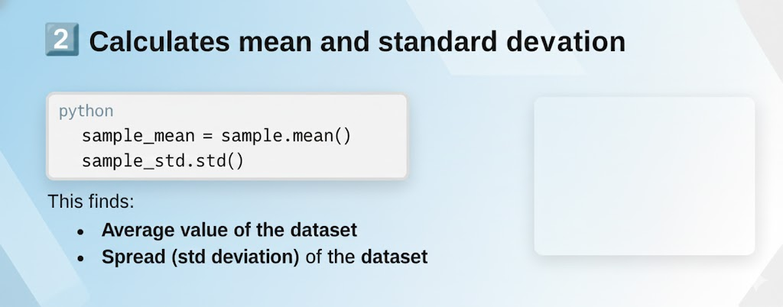

Slide 4
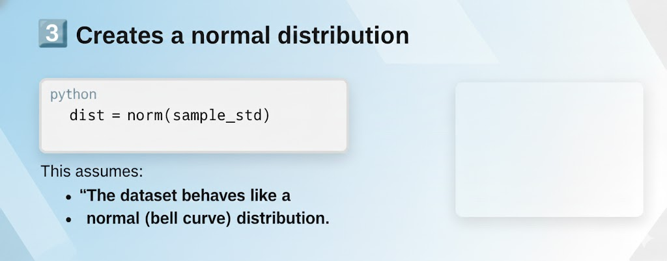

Slide 5
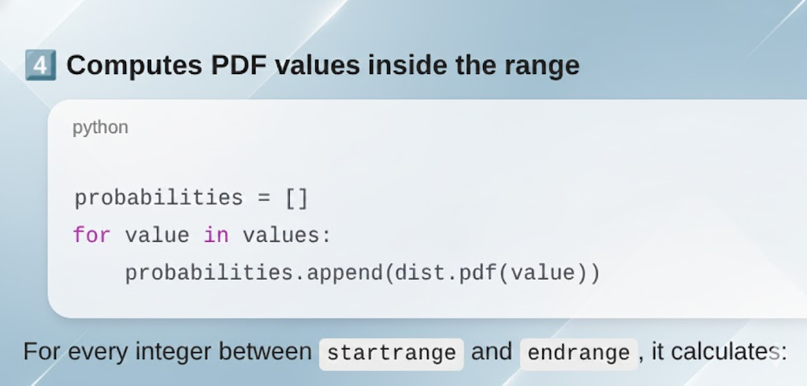

Slide 6
